Slide 1
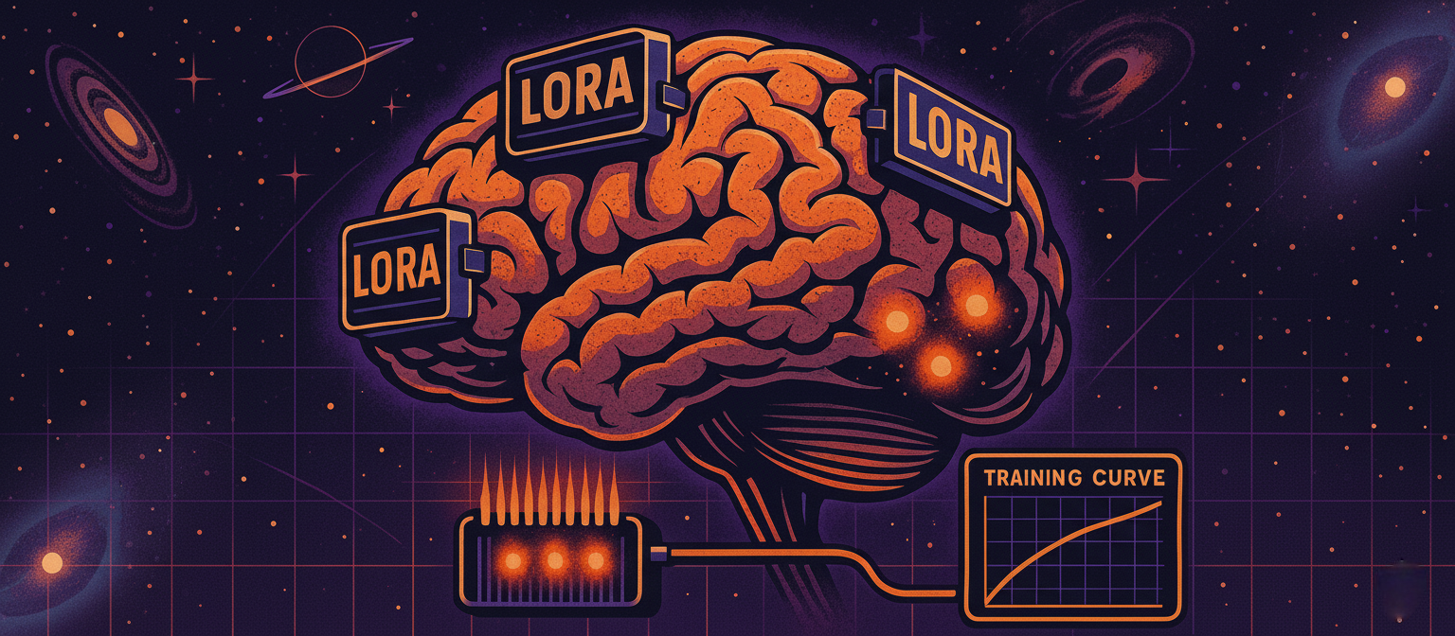
LLM Engineering
MASTER AI & LARGE LANGUAGE MODELS

Slide 2

PROGRESS REPORT
Less talking, more action!
What you can now do
Generate text and code with Frontier Models including AI Assistants with Tools, and with open-source models with HuggingFace transformers
Create advanced RAG solutions with LangChain
Follow a 5 step strategy to solve problems, including dataset curation
After today you will be able to:
Explain the role of a baseline model
Create a traditional ML solution with features and linear regression
Apply NLP techniques and advanced ML models like XGBoost

Slide 3

REFRESHER
The Price Is Right
Given a description of a product, predict its price
Using curated data, taken from a Hugging Face dataset of scraped Amazon products, pre-processed using GPT-OSS-20B via Groq
This will ultimately be incorporated in an Agentic Solution that will hunt for bargains
Evaluate with absolute price difference

Slide 4
The Price Is Right
THE ORDER OF PLAY:
Week 6: Data Curation, Evaluation, Frontier Models
Day 1: Curate the data
Day 2: Pre-process the data
Day 3: Baseline Models & Traditional ML
Day 4: Neural Networks and Frontier LLMs
Day 5: Fine-Tuned Frontier LLM
Week 7: Fine-tune Open-Source LLM
Week 8: Deployed model, RAG, Agentic Product

Slide 5

The importance of a Baseline
Start cheap and simple
Gives a benchmark to improve on
An LLM might not be the right solution

Slide 6
Machine Learning
A branch of AI where algorithms learn from data to make predictions without being explicitly programmed.
These days, ML is most often used in the context of traditional ML, pre-Deep Learning & LLMs
It’s still crucial to understand core ML principles to be an LLM practitioner
Generalizing - The ability to perform well on new, unseen data by capturing underlying patterns
Overfitting - When a model mimics the training data too closely, leading to poor performance on unseen data
The goal of Machine Learning is to GENERALIZE - to make accurate predictions on unseen data

Slide 7
CAPSTONE
3 Alternative Ways to Follow
1
2
3
Focus on intuition Watch lectures and see the results, recreate the final result
Follow along
Use the Lite version of the dataset (20,000 vs 800,000)
Don’t curate the data - use mine
Estimate: $0-$5
Dig deep
Use the full dataset, curate and train fully - significant work but VERY satisfying!
Estimate: $5-35

Slide 8

PROGRESS
Next stop: the Frontier
What you can now do
Generate text and code with Frontier Models including AI Assistants with Tools, and with open-source models with Hugging Face transformers
Create advanced RAG solutions with LangChain
Follow a 5 step strategy to solve problems, including dataset curation and making a baseline model with traditional ML
After the next session you will be able to:
Build a vanilla neural network
Run a business problem against a frontier model
Compare leading frontier models at a business task

